Slide 1
Input and Output

Slide 2
Learning target
This chapter introduces :
  Output data on the screen
  Read data from the user input
  Output data to a file
  Input data from a file

Slide 3
The output of different data types
After initializing variables
  Python will automatically recognize and determine the data type

Slide 4
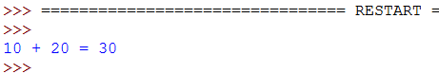
Output of integer variables
E.g:
Result:
num1=10 #Integer variable num1
num2=20 #Integer variable num2
#Output strings and integers variables
print(num1,"+",num2,"=",num1+num2)
num1+num2
num1
num2

Slide 5

Output of floating-point variables
  num1=10.1 # Floating point variable
  num2=20 # Integer variable
  #Output string and floating point number
  print(num1,"+",num2,"=",num1+num2)
E.g:
Result:
num1
num2
num1+num2

Slide 6
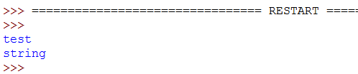
Output of string
E.g:
  Result:
  string= "test"
  print(string)#Output the content of the string variable
  print("string")#Output the string in “”
print(string)
print("string")

Slide 7

Output of the complex number
E.g:
Result:
  num1= 1.5 + 0.5j
  print(num1.real,"\t",num1.imag)
  #num1.real is the real part of the variable num1
  #num1.imag is the imaginary part of the variable num1
\t
num1.real
num1.imag

Slide 8
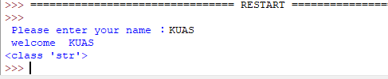
Read data from the user input
Syntax:
E.g:
Result:
the_variable_name = input(" Please enter your name ：")
print(" welcome ", the_variable_name)
  name =input(" Please enter your name ：")
  # name is a string variable
  print(" welcome ", name)
  print(type(name)) # Display the data type of the name variable
  Input type
  String type

Slide 9

Convert the input data type
Syntax:
the_variable_name = Data_Types(input(" type in data "))
print(the_variable_name )
E.g:
Result:
  num =int (input(" Type in data "))
  #Convert the string to an integer
  print("The number entered is:", num)
  print(type(num))
  Input type
  Integer type

Slide 10
Read or write a File
The following slides will briefly describe how to read or write a file
  Helpful for reading or recording the results generated by the program

Slide 11
File handling
The key function for working with files in Python is the open() function
The open() function takes two parameters
  filename
  mode

Slide 12
Modes for opening a file
"r“: Read (Default value)
  Opens a file for reading, error if the file does not exist
"a“: Append
  Opens a file for appending, creates the file if it does not exist
"w“: Write
  Opens a file for writing, creates the file if it does not exist
"x“: Create
  Creates the specified file, returns an error if the file exists
"t“: Text
  Default value. Text mode
"b": Binary
  Binary mode (e.g. images)

Slide 13
Open and close a file
Syntax:
    f = open("FILENAME", "MODE")#Open file
    #The default mode is read file
    print("Stored content", file = f)
    f.close()#Close file

Slide 14
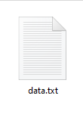
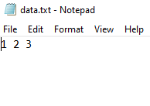
Write a file
E.g:
Result:
  f1 = open("data.txt", "w") #Write the file
  print(1,2,3,file = f1)
  f1.close() #Close file
  #data.txt is the name of the output file
  #”w” is the mode for opening the file

Slide 15
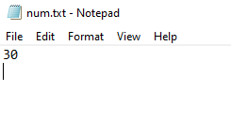
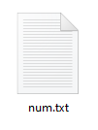
Write a file
E.g:
Result :
  num1=20 #Integer variable 1
  num2=10 #Integer variable 2
  print(num1+num2, file = open("num.txt", "w"))
  # num.txt is the name of the output file
  # “w” is the mode for opening the file

Slide 16
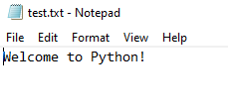

Read a file
Read test.txt:
Result：
  file = open(“test.txt", "r") #Open a specified file
  for line in file :#Read data (string) through the file line by line
  print(line)
  file.close()#Close file

Slide 17

Read a file
Read a file encoded with UTF-8 :
Result：
  # Read the specified file name
  name = input(" Please enter the file name ：")
  file = open(name, "r", encoding="UTF-8")# UTF-8 encoded
  content = file.read() #Read data
  print(content)
  file.close()#Close file

Slide 18
Sources
References:
  http://openhome.cc/Gossip/Python/IOABC.html
  http://www.pythondoc.com/pythontutorial3/introduction.html
  http://pydoing.blogspot.tw/2011/01/python-operator.html
  Python 深入淺出程式設計

Slide 19
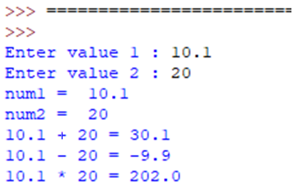
Exercise 1
Design a program that allows the user to enter two values, and can show the results of the addition, subtraction, and multiplication of the two values on the screen
User input :
10.1
20
Result :

Slide 20
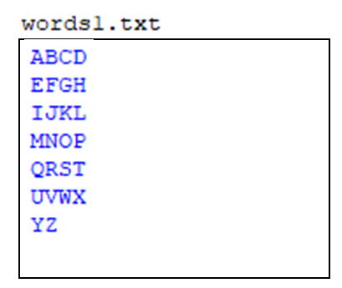
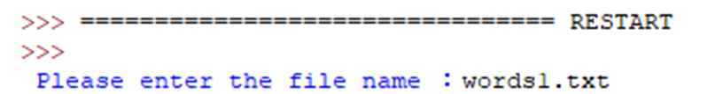
Exercise 2
Write a Python program that can print all letters of the English alphabet in a specified file, where each line in the file has at most 4 letters
Result :

Slide 21
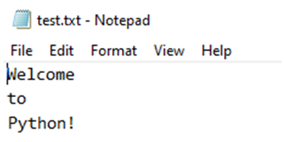

Exercise 3
Write a Python program that can read test.txt and output the number of lines in the file
Result :

Slide 22

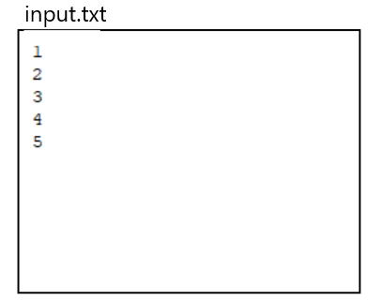
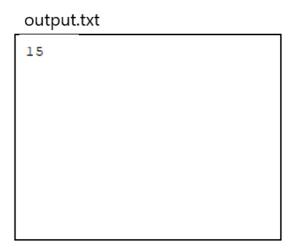
Exercise 4
Write a Python program to read data from a file and output the sum of the data to another file.
Result :

